Slide 1

Stage 2 Unflipped L Course Designer: Ken Wang
Unflipped L is a 24 round, 120 point, COMSTOCK Long course. There are 11 USPSA targets and 2 steel targets. The best 2 hits per cardboard target will score. Steel must fall to score.
The Handgun start position is feet touching marks with wrists below belt. Handgun is loaded and holstered. The PCC start position is feet touching marks. PCC loaded with stock on belt, safety on.
On the audible start signal, engage all targets from within the shooting area.

Slide 2
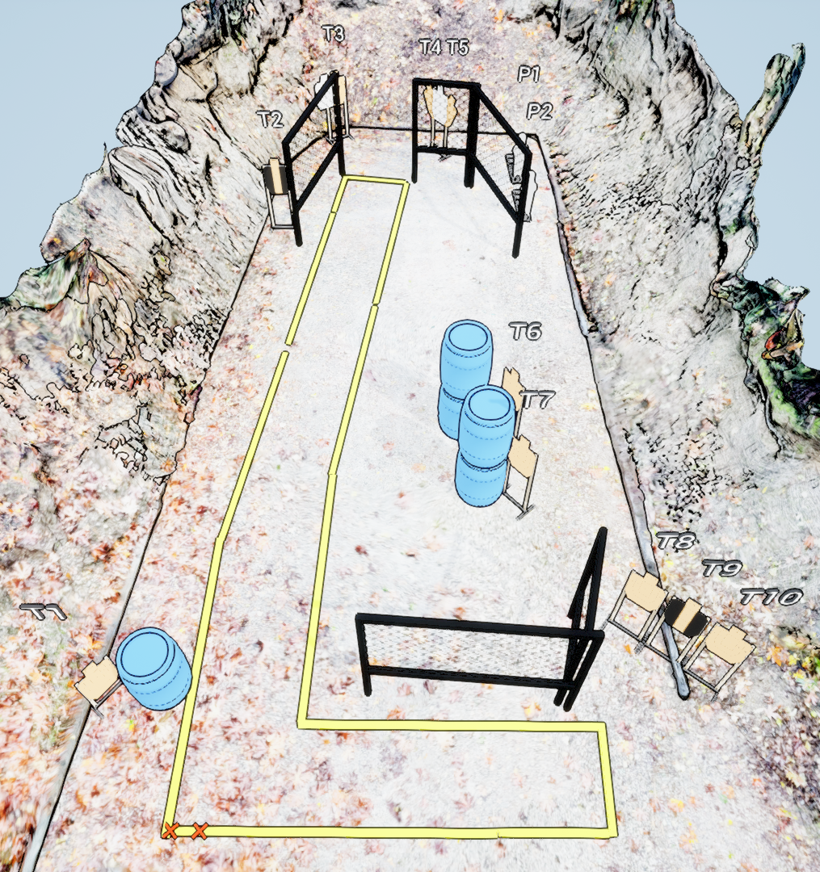
 | Stage 2 Unflipped L Course Designer: Ken Wang

